Slide 1
ELECTRICAL SCIENCE – 2 (15B11EC211) UNIT – 6 LECTURE 4

Slide 2
Lecture Overview
Biasing and its need
Operating Point
Different Biasing Circuits
Voltage Divider Bias Configuration
Load Line Analysis
Numerical
References

Slide 3
Biasing Circuit
Biasing is application of dc voltages to establish a fixed level of current and voltage.
Need of Biasing
To turn the device “ON”
To place it in operation in the region of its characteristic where the device operates most linearly .
Improper biasing causes
Distortion in the output signal
Clipped output signal

Slide 4
Important Relationships
I _{E} = I_{C} + I _{B}
I _{E} =(β + 1)I _{B}
β = I_{C}/I_{B}
V_{CB} = V_{CE} - V _{BE}

Slide 5
Operating Point [2]
For transistor amplifiers the resulting dc current and voltage establish an operating point on the characteristics that define the region that will be employed for amplification of the applied signal.
Because the operating point is a fixed point on the characteristics, it is also called the quiescent point (abbreviated Q-point).
Transistor Regions Operation:
Linear(Active)-region operation: Base–emitter junction forward-biased Base–collector junction reverse-biased
Cutoff-region operation: Base–emitter junction reverse-biased Base–collector junction reverse-biased
Saturation-region operation: Base–emitter junction forward-biased Base–collector junction forward-biased

Slide 6
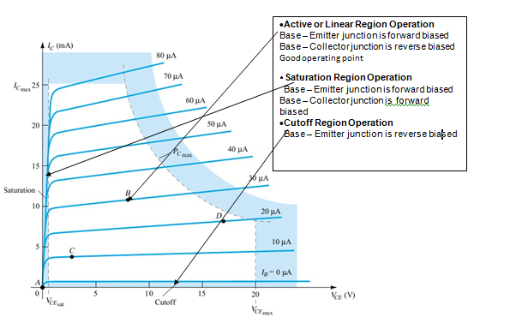
Operating Point

Slide 7
Biasing Circuits
Fixed-bias circuit
Emitter-stabilized bias circuit
Voltage divider bias circuit
DC bias with voltage feedback

Slide 8
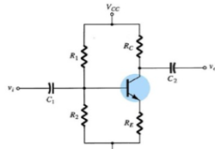
VOLTAGE DIVIDER BIAS CIRCUIT [1]
Provides good Q-point stability with a single polarity supply voltage.
This is the biasing circuit wherein, I_{CQ} and V_{CEQ} are almost independent of beta (β).
The level of I_{BQ} will change with beta so as to maintain the values of I_{CQ} and V_{CEQ} almost same, thus maintaining the stability of Q point.

Slide 9
For analyzing a voltage divider bias circuit are:
1st step: Locate capacitors and replace them with an open circuit
2nd step: Simplified circuit using Thevenin Theorem
3rd step: Locate 2 main loops which;
BE loop
CE loop

Slide 10
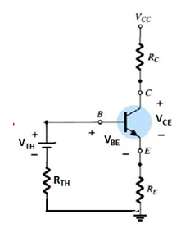
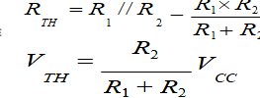
Simplified circuit using Thevenin Theorem

Slide 11
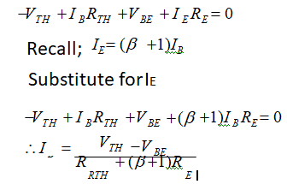
BE Loop Analysis

Slide 12
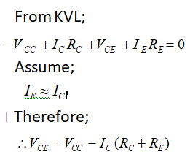
CE Loop Analysis

Slide 13
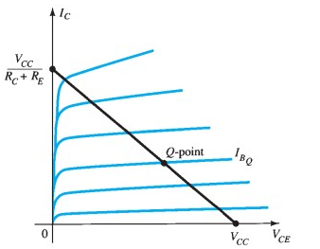
Load Line Analysis

Slide 14
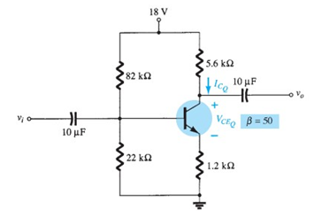
Numerical [1]
Find I_{c} & V_{CE} ::

Slide 15
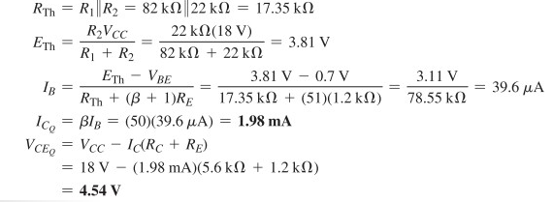

Slide 16
References
[1] R. Boylestad and L. Nashelsky, ‘Electronic Devices and Circuit Theory’, PHI, 7e, 2001
[2] A. S. Sedra,, and K. C. Smith, ‘Microelectronic Circuits’. Oxford Oxford University Press, 7th Edition, 2012
[3] D.C. Kulshreshtha, ‘Electronic Devices and Circuits’, New Age, 2e, 2006

